Slide 1
Social Anxiety classifier
5.11.18

Slide 2
The task
Original data – 74 subjects
Clinical – 34
High – 20
Low - 20
Changes – removed 4 (2 high 2 low), 2 from clinical moved to low
Added 13 low.
Goal – classify between the high and clinical from the low.

Slide 3
Describe data
Number of Features – 154
Number of subjects - 83
Low- 33
high – 50
Update – 2 clinical subjects with low LSAS

Slide 4
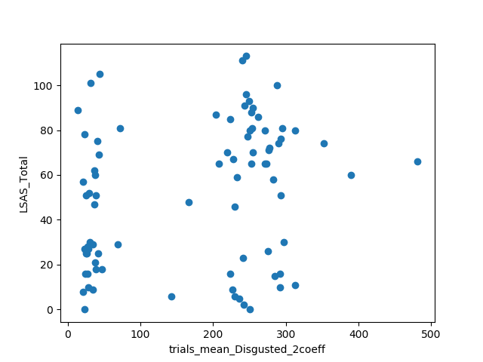
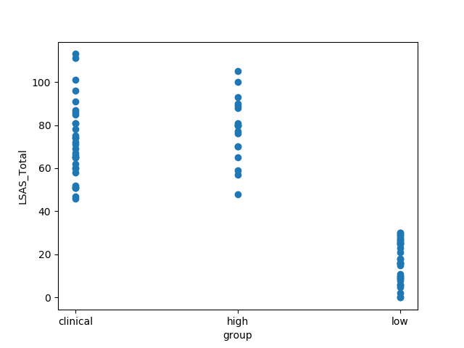
LSAS graphs

Slide 5
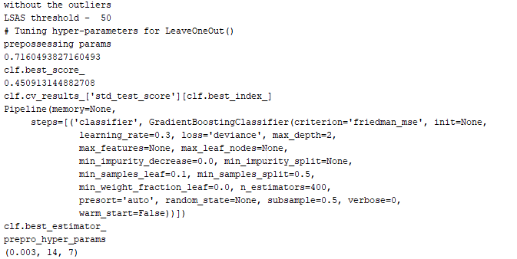
Cut off example

Slide 6
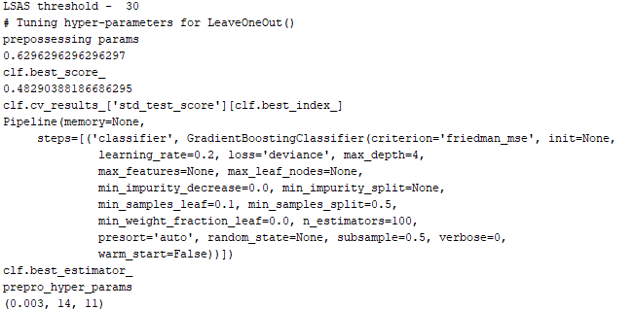
Cutoff - 30

Slide 7
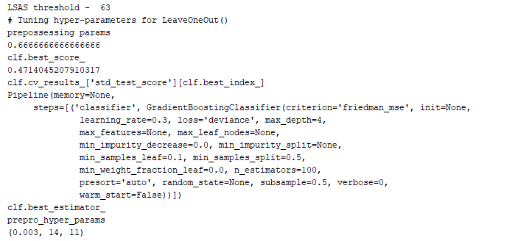
Cutoff - 63

Slide 8
Amit’s Feature

Slide 9
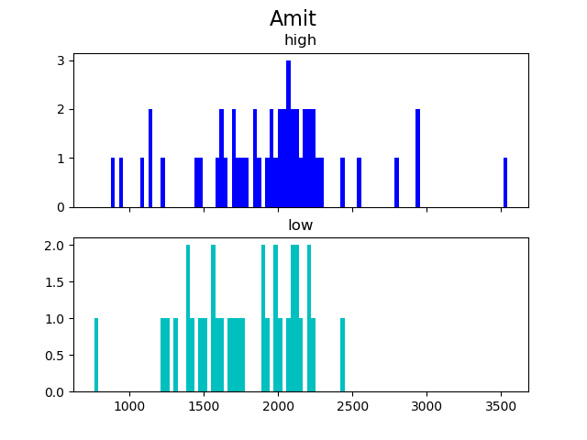
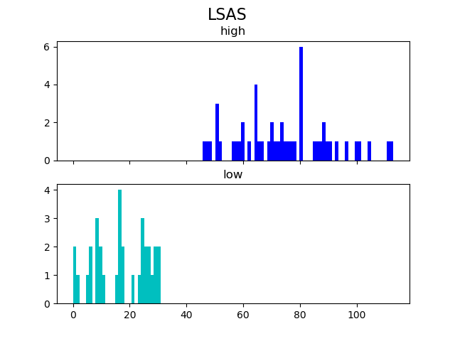
Describe
Average of Dwell time on Disgusted AOI
over the different trials.

Slide 10
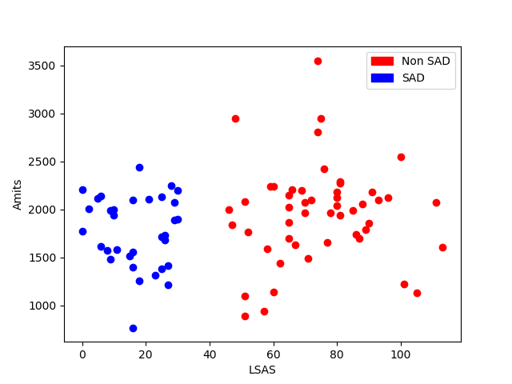
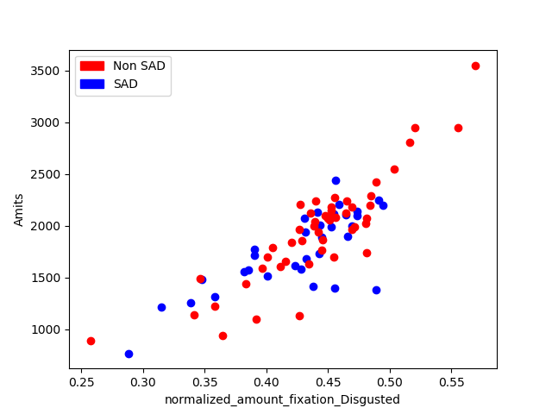
Amit’s feature graphs

Slide 11
Feature importance
Feature importance – random
Removing high correlation features
High correlation:
['%threat - #2', 'amount_DD_transitions', 'norm_amount_DD_transitions’, 'normalized_amount_fixation_Disgusted’, 'normalized_mean_fixation_length_Disgusted',
'normalized_sum_fixation_length_Disgusted’, 'sum_fixation_length_Disgusted', 'trials_norm_amount_Disgusted_mean’, 'trials_ratio_D_DN2_est_mean', 'trials_ratio_D_DN_est_mean’, 'trials_ratio_N_DN_est_mean’], dtype='object’)
Feature importance (over 1000 runs)
Mean- 49.066 STD - 22.048846772563866

Slide 12
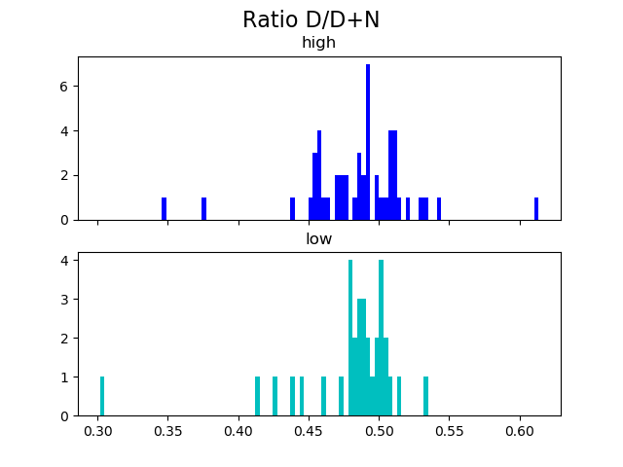
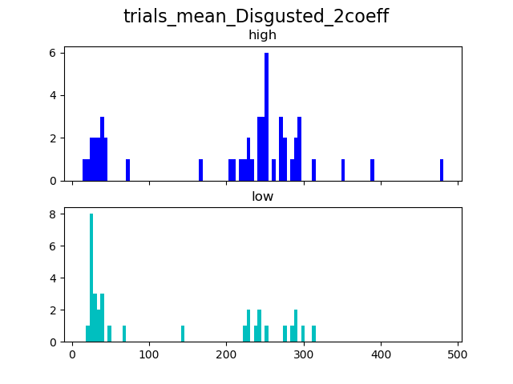
Graphs

Slide 13
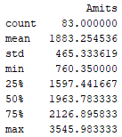


Describe
Outliers – 9020, Amits of 3545.983

Slide 14
Classify with Amit’s feature Only
only Amit's feature
With CV = 5 , best score 0.7108433734939759
With LOO
best score 0.6385542168674698
With 2 outliers in low group
0.6144578313253012 STD -0.4867231295596183

Slide 15
Without Amit’s feature
With LOO CV -
best score - 0.7710843373493976
best STD - 0.4201348379316312
With 2 outliers in low group
best score - 0.7228915662650602
best STD - 0.447570496891728

Slide 16
Amit’s feature – Linear Regression
Linear regression
STD - 0.03574276239422791
RMSE - 30.88936325594743

Slide 17
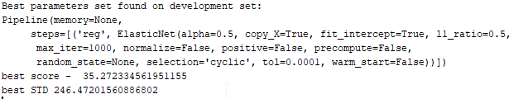
Regression – All features
Linear Regression with all the features:
With overfit -
Mean - 26.460938364794007
Std 0.29240382315880176

Slide 18
Pipeline
1. remove missing values
2. scaling - minmax
3. variance threshold
4. correlation threshold – 0.7
5. random forest feature importance
6. PCA
7. Classifier – Gradient Boosting / Random forest

Slide 19
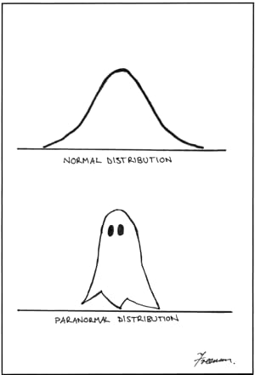
Statistics

Slide 20
Amit’s feature
Original data –
High vs low – significant
Low vs clinical – not significant
Low vs clinical + high – significant
Our data -
High vs low – significant
Low vs clinical – not significant
High + clinical vs low - significant

Slide 21
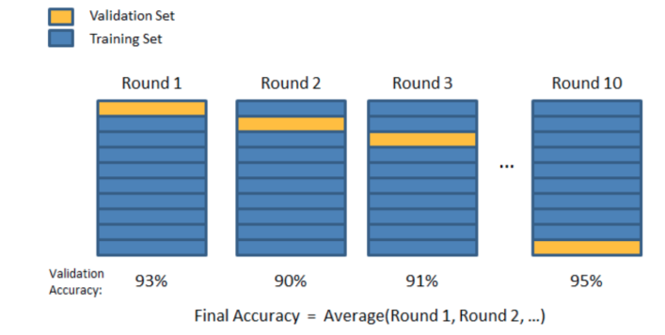
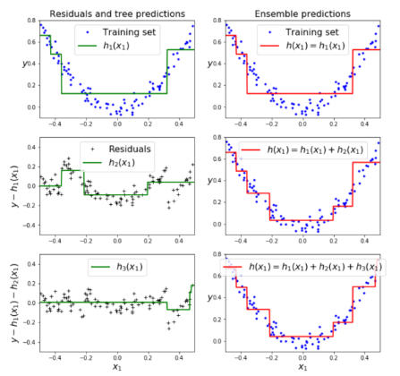
K Fold Cross Validation

Slide 22
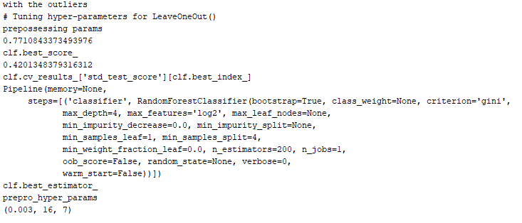
With the outliers– with LOO

Slide 23
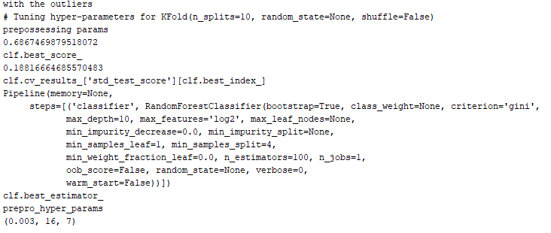
With the outliers– with 10 Folds

Slide 24
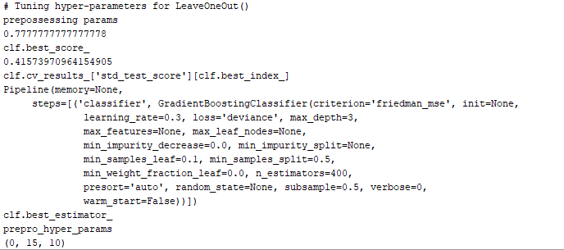
Without the outliers - LOO

Slide 25
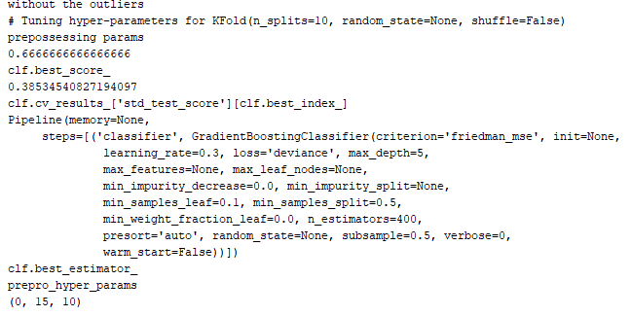
Without the outliers – 10 folds

Slide 26
Grid search vs naïve Classifier
Calculated with LOO (n=83)
Naïve classifier –
with the outliers - naive classifier score 0.6024096385542169
without the outliers - naive classifier score 0.6172839506172839

Slide 27
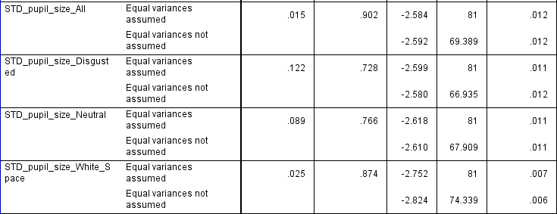
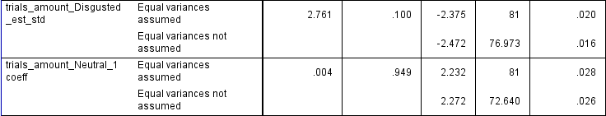
Features statistics

Slide 28
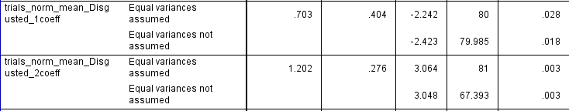
Features statistics

